Slide 1
APPLE INC.
Statement of Cash flow Statement

Slide 2
Sources of cash in each of the three sections of the statement of cash flows
Operating activities
Proceeds from sales of marketable securities
Proceeds from maturities of marketable securities
The operating activities in this regard comprised of more cash outflows as compared to cash inflows.
Notes:
Operating activity cash flows include transactions, adjustments, and changes in value not defined as investing or financing activities.

Slide 3
Sources of cash(Cont…)
Investing activities
Proceeds from issuance of term debt
Proceeds from (repayments of) commercial paper
Financing Activities
Cash, cash equivalents and restricted cash

Slide 4
Uses of cash in each of the three sections
Operating activities
Purchases of marketable securities - Purchased marketable securities were about $76, 923m , $109,558m, and $114,938m for three consecutive quarters
Payments for acquisition of property, plant and equipment - This amounted to $10,708m, $11,085m and $7,309 for three consecutive years
Investing activities
Payments for taxes - There was payments for taxes related to net share settlement of equity awards
Payments for dividends - Payments for dividends and dividend equivalents amounted to $14,400m and $14,800m for two consecutive quarters
Notes:
Investing activity cash flows include making and collecting loans and acquiring and disposing of debt or equity instruments and property, plant, and equipment and other productive assets.

Slide 5
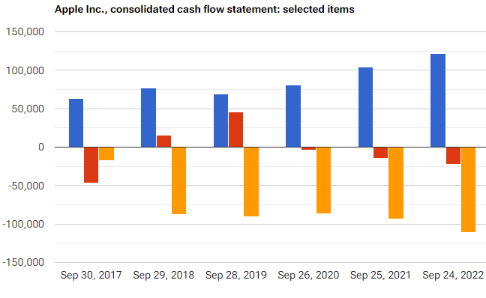
Uses of cash(Cont…)
Financing activities
The only item in this case was Cash, cash equivalents and restricted cash, beginning balances.
Notes:
Financing activity cash flows include obtaining resources from owners and providing them with a return on, and a return of, their investment; borrowing money and repaying amounts borrowed, or settling the obligation; and obtaining and paying for other resources obtained from creditors on long-term credit.

Slide 6
Differences Between Net Income and Cash
Considering the last quarter of 2022, the net income was $99,803m. Operating cash amounted to $122,151m.
Net income is the profit a company has earned for a period
Cash flow from operating activities measures, in part, the cash going in and out during a company's day-to-day operations.
Free cash flow is basically the cash that a company generates from its business operations after subtracting capital expenditures.

Slide 7
Net Income vs. Operating Cash Flow
Net Income is the result of revenues minus the expenses, taxes, and costs of goods sold (COGS).
Operating cash flow is the cash generated from operations, or revenues, less operating expenses.
Investors and analysts prefer using operating cash flow as an indicator of a company's health.
Net income is important to investors and analysts but does not necessarily provide a complete picture of a company's development.

Slide 8
Reconciling Items
Non-cash items - Items that don't reduce cash, but they still get recorded as an income statement expense that reduces net income.
Timing differences including assets and liabilities - Such adjusting entries compensate for the way companies recognize revenue and expenses under accrual accounting
Non-operating gains or losses, i.e., income or losses generated by activities other than the core functions of Apple Inc. Company

Slide 9
Summary of Strength and Weaknesses
Strengths
Apple Inc. cash generated by operating activities increased from 2020 to 2021 and from 2021 to 2022 ($122.151B, a 17.41% increase from 2021).
In this regard, cash flow from operating activities indicates that the core business activities of the company are thriving.
Apple Inc. cash used in financing activities decreased from 2020 to 2021 and from 2021 to 2022.
Most of the capital is coming from the normal business operations.
Weaknesses
Apple Inc. cash (used in) generated by investing activities decreased from 2020 to 2021 and from 2021 to 2022.
The company is therefore not doing enough in pursuit of long term growth.
Notes:
Increasing cash flow from the operating activities provides as additional measure/indicator of profitability potential of a company, in addition to the traditional ones like net income or EBITDA. Apple’s cash is coming from normal business operations, and that's a sign of a good investment.

Slide 10
References
Apple Inc. (2022). APPLE INC. Management's discussion and analysis of financial condition and results of operations (form 10-Q). https://www.marketscreener.com/quote/stock/APPLE-INC-4849/news/APPLE-INC-Management-s-Discussion-and-Analysis-of-Financial-Condition-and-Results-of-Operations-f-37670324/
Macrotrends.(2022). https://www.macrotrends.net/stocks/charts/AAPL/apple/cash-flow-statement

